Slide 1
Flight Delay Prediction through Machine Learning
Presented By:
Raghav Pandya, Chintan Trivedi, Krishna Anantha Padmanabhan
Mentors
Dr. James Abello
Ms. Tugba Kulahcioglu

Slide 2
Project Goal
The aim is to predict whether the flights will be delayed for departure.
Find out the delay for the flight.

Slide 3
Outline
Description
User Interface
Stumbling blocks
Flow diagrams
Integrity Constraints
Sample findings
  Comparisons of various classifiers based on accuracy
Summary
Ideas for extension
Acknowledgements
References and Resources
Demo

Slide 4
Description
Develop a system which predicts a delay on flight departure based on certain parameters
Compares the accuracy of various Machine Learning classifiers such as J48, NBTree, RandomForest, Simple Naïve Bayes, etc.
Classifies the dataset based on the J48 classifier and makes use of Multiple Linear Regression to predict delay.
Probabilistic delay representation based on Carrier, Airport.

Slide 5
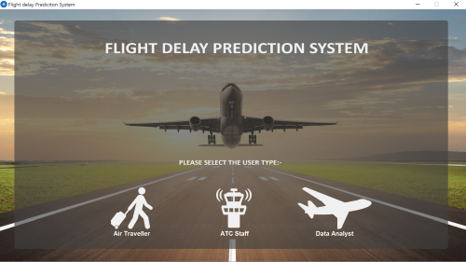
User Interface – Main Screen

Slide 6
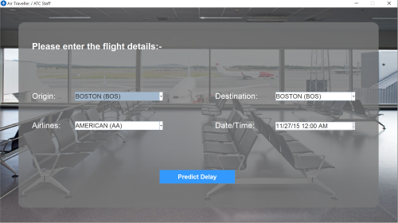
User Interface – Air Traveller/ ATC Staff

Slide 7
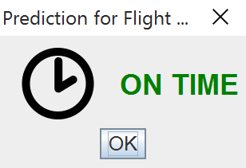
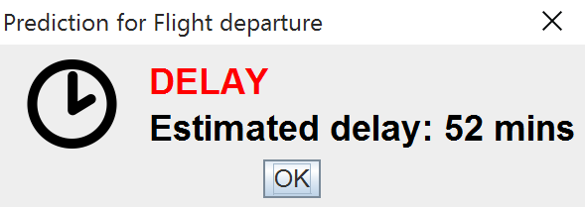
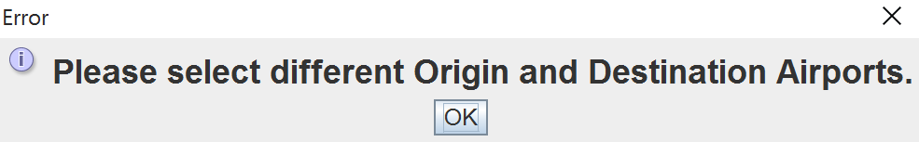
User Interface – Prediction of Delay

Slide 8
Stumbling Blocks
Since our initial proposal was rejected we had to come up with a new proposal in a short period of time.
Identification of the features needed for our classifier took a lot of effort.

Slide 9
Flow of Assignments
Raghav: Data curation, UI, Integration of components
Krishna: Implementation of different classifiers with acceptable accuracy, Overall Testing
Chintan: Multiple-linear regression model, UI

Slide 10
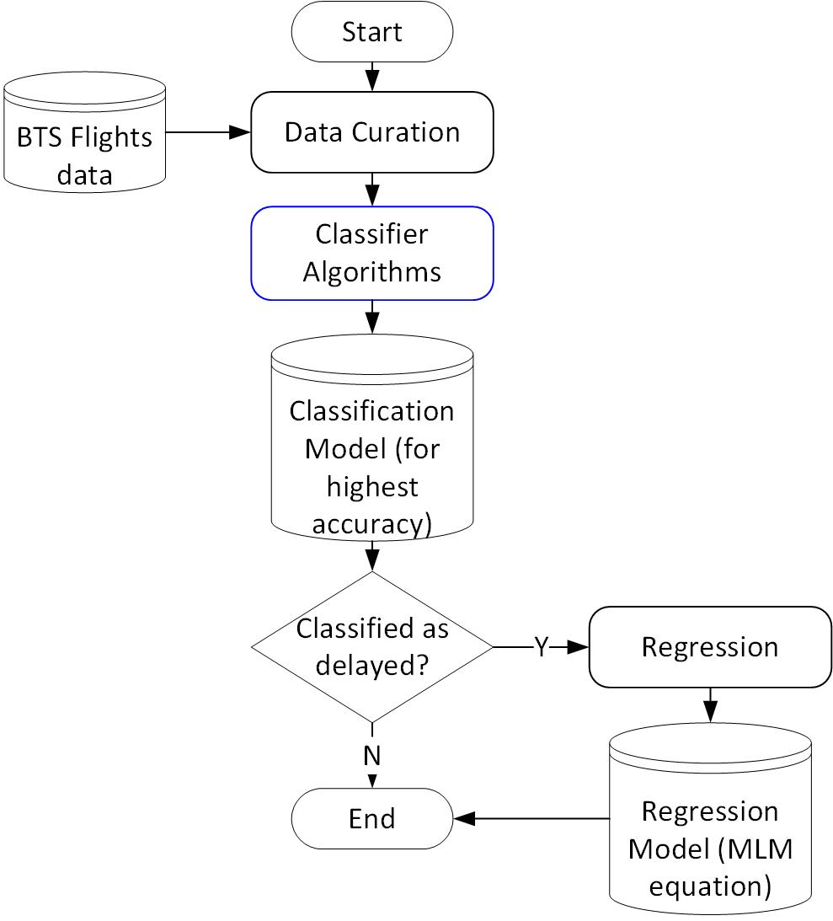
Flow Diagram - Classification and Regression Model

Slide 11
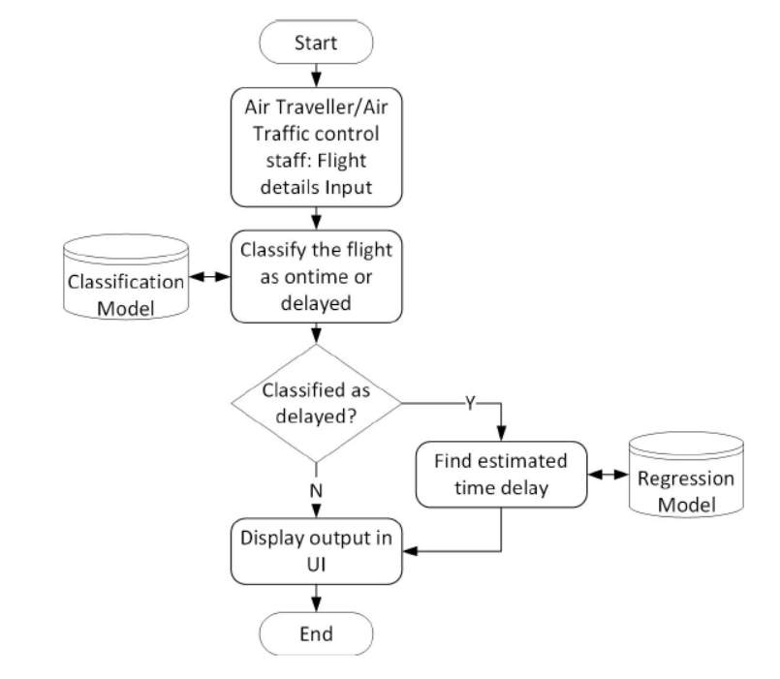
Flow Diagram - Project

Slide 12
Integrity Constraints
This system has three main integrity constraints:
Data curation: The data given to the classifier must not have any null values and all attributes must be in their respective data type, whether numeric or string.
Classifier output: The classifier should predict with at least 60% accuracy when testing with the validation data. Here, the regression must be calculated only for delayed flights and not otherwise.
Regressor output: Regression must be carried out only for linear data obtained from the classifier’s output.

Slide 13
Dataset Attributes
Origin:- Departure City/Airport
Airline:- Flight Carrier
Distance:- Flight length in miles
Day of Week
Day of Month
Delay:- Class 0 if delayed, 1 otherwise
Departure delay:- delay time in mins

Slide 14
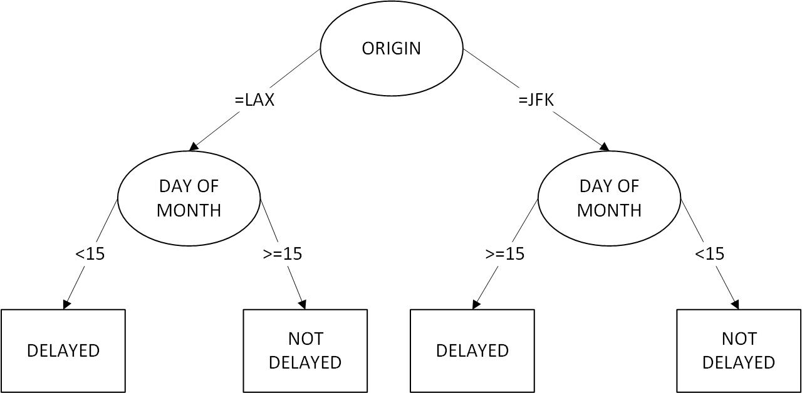
Classifier Model: Sample Decision Tree
A sample classification model with two attributes generated by J48 classifier.

Slide 15
Classifier Model Observations
Attributes in their decreasing order of influence on departure delay:-
Departure Time
Origin Airport
Airlines
Day of Month
Day of Week

Slide 16
Initial Findings – Classifier
J48 Classifier:
  Tree Size: 208
  Leaf size: 142
  Accuracy: 86.39%
NBTree Classifier:
  Tree Size: 12
  Leaf size: 9
  Accuracy: 85.80%

Slide 17
Initial Findings – Classifier
RandomForest
  100 trees, each constructed while considering 3 random features.
  Out of bag error: 0.1515
  Accuracy: 84.41%
Rule based Classifier:
  Number of Rules : 1218
  Accuracy: 86.29%
  Simple Naïve Bayes Classifier
  Accuracy: 85.75%

Slide 18
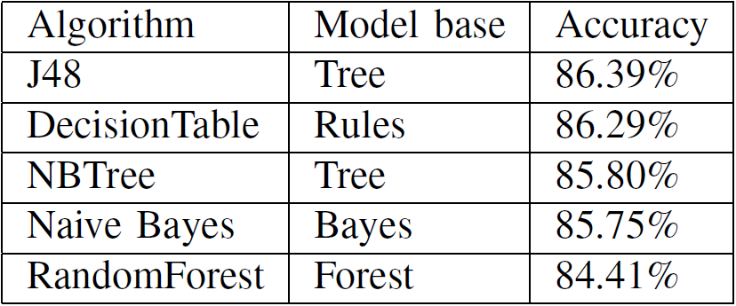
Initial Findings – Comparison of classifiers

Slide 19
Multiple Regression Model
Regression equation:-
DEPDELAYNEW = 4.2139 * DAYOFMONTH=26,23,30,12,25,
27,24,20,15,28,21,2,14,7,3,18,4,17,10,8 +
3.7402 * DAYOFMONTH=15,28,21,2,14,
7,3,18,4,17,10,8 +
4.9167 * DAYOFMONTH=18,4,17,10,8 +
3.503 * DAYOFMONTH=17,10,8 +
6.7863 * DAYOFMONTH=8 +
7.2751 * CARRIER=MQ,B6,AA,DL,OO,EV,UA +
3.4147 * CARRIER=AA,DL,OO,EV,UA +
5.0166 * CARRIER=EV,UA +
5.03 * ORIGIN=DEN,LAX,JFK,EWR,BOS,ORD +
-3.6498 * ORIGIN=EWR,BOS,ORD +
5.4878 * ORIGIN=BOS,ORD +
9.5943 * DEPTIME=0,2 +
26.2807
Correlation coefficient: 0.1919

Slide 20
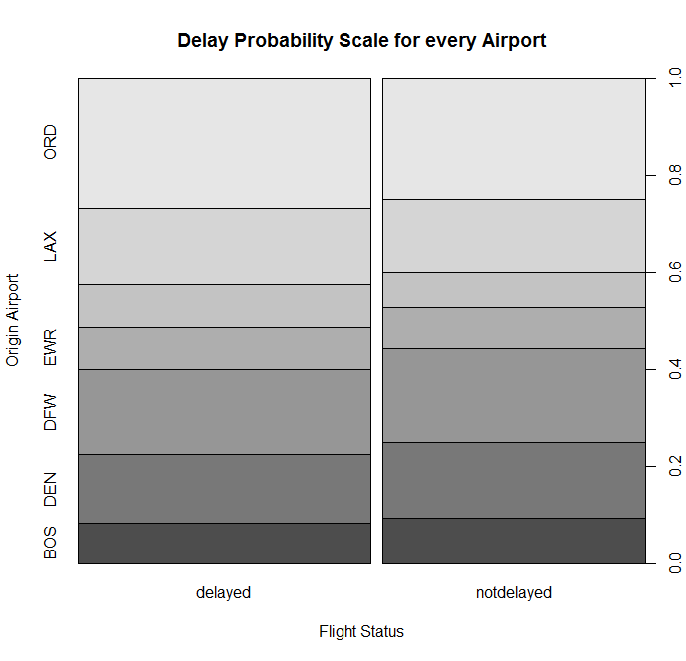
Statistical Findings (1)

Slide 21
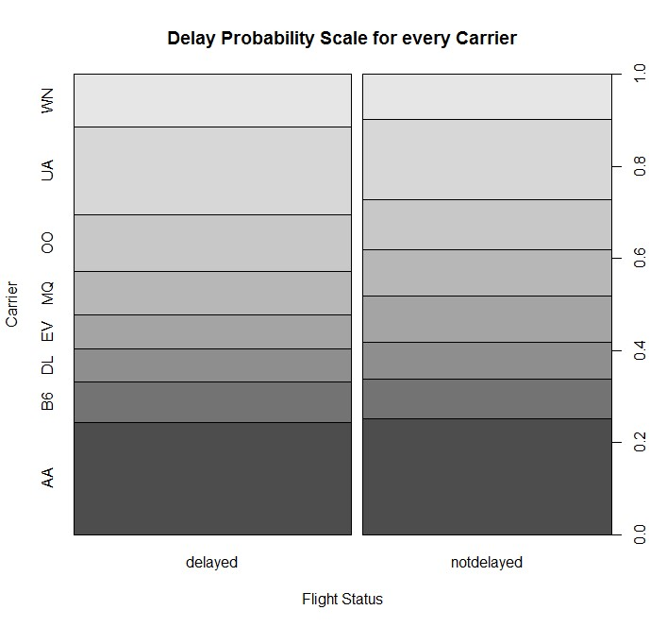
Statistical Findings (2)

Slide 22
Summary
Our final application is an easy to use desktop application.
It works as intended and has a good accuracy for predicting delay.
The accuracy of predicting delay time is not accurate because of insufficient data.
It is helpful for air travelers, ATC staff and for data analysts.

Slide 23
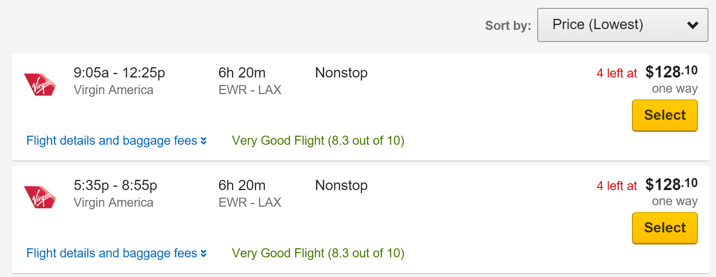
Possible project application
Add flight delay chances/prediction next to booking flights like on expedia.com

Slide 24
Ideas for Extension
The project can be extended to include arrival time as well.
By developing a better algorithm than NBTree or J48/C4.5 we could achieve a greater accuracy.
One could also increase the number of options presented to different users, such as delays at particular airports, delays of all flights at a specific date, etc.

Slide 25
Acknowledgements
We thank our mentor Dr. James Abello for motivating us to do such an interesting project through which we gained hands-on experience on top of our theoretical knowledge.
We also thank Ms. Tugba Kulahcioglu for her valuable inputs throughout all the phases of the project.

Slide 26
References and Resources
R. Kohavi, ’Scaling Up the Accuracy of Naive-Bayes Classifiers: A Decision-Tree Hybrid’, CiteSeer, pp. 202–207, 1996.
M. Hall, ’A decision tree-based attribute weighting filter for naive Bayes’, Elsevier, vol. 20, no. 2, pp. 120–126, 2007.
R. S. Michalski and J. G. Carbonell and T. M. Mitchell, ’Machine learning: An artificial intelligence approach’, Springer Science & Business Media, 2013.
I. Rish, ’IJCAI 2001 workshop on empirical methods in artificial intelligence’, IBM New York, vol. 3, no. 22, pp. 41–46, 2001.
D. Y. Mahmood and M. A. Hussein, ’AnalyzingNB, DT and NBTree Intrusion Detection Algorithms’, Journal of Zankoy Sulaimani-Part A (JZS-A), vol. 16, no. 1, pp. 1, 2014.
Transtats.bts.gov, ’RITA — BTS — Transtats’, 2015. [Online]. Available: http://www.transtats.bts.gov/DL_SelectFields.asp?Table_ID=236&DB_Short_Name=On-Time. [Accessed: 01- Nov- 2015].
Ian H. Witten and Eibe Frank (2005). Data Mining: Practical Machine Learning Tools and Techniques. 2nd Edition, Morgan Kaufmann, San Francisco.
Mark Hall, Eibe Frank, Geoffrey Holmes, Bernhard Pfahringer, Peter Reutemann, Ian H. Witten (2009); The WEKA Data Mining Software: An Update; SIGKDD Explorations, Volume 11, Issue 1.

Slide 27
DEMO

